Slide 1
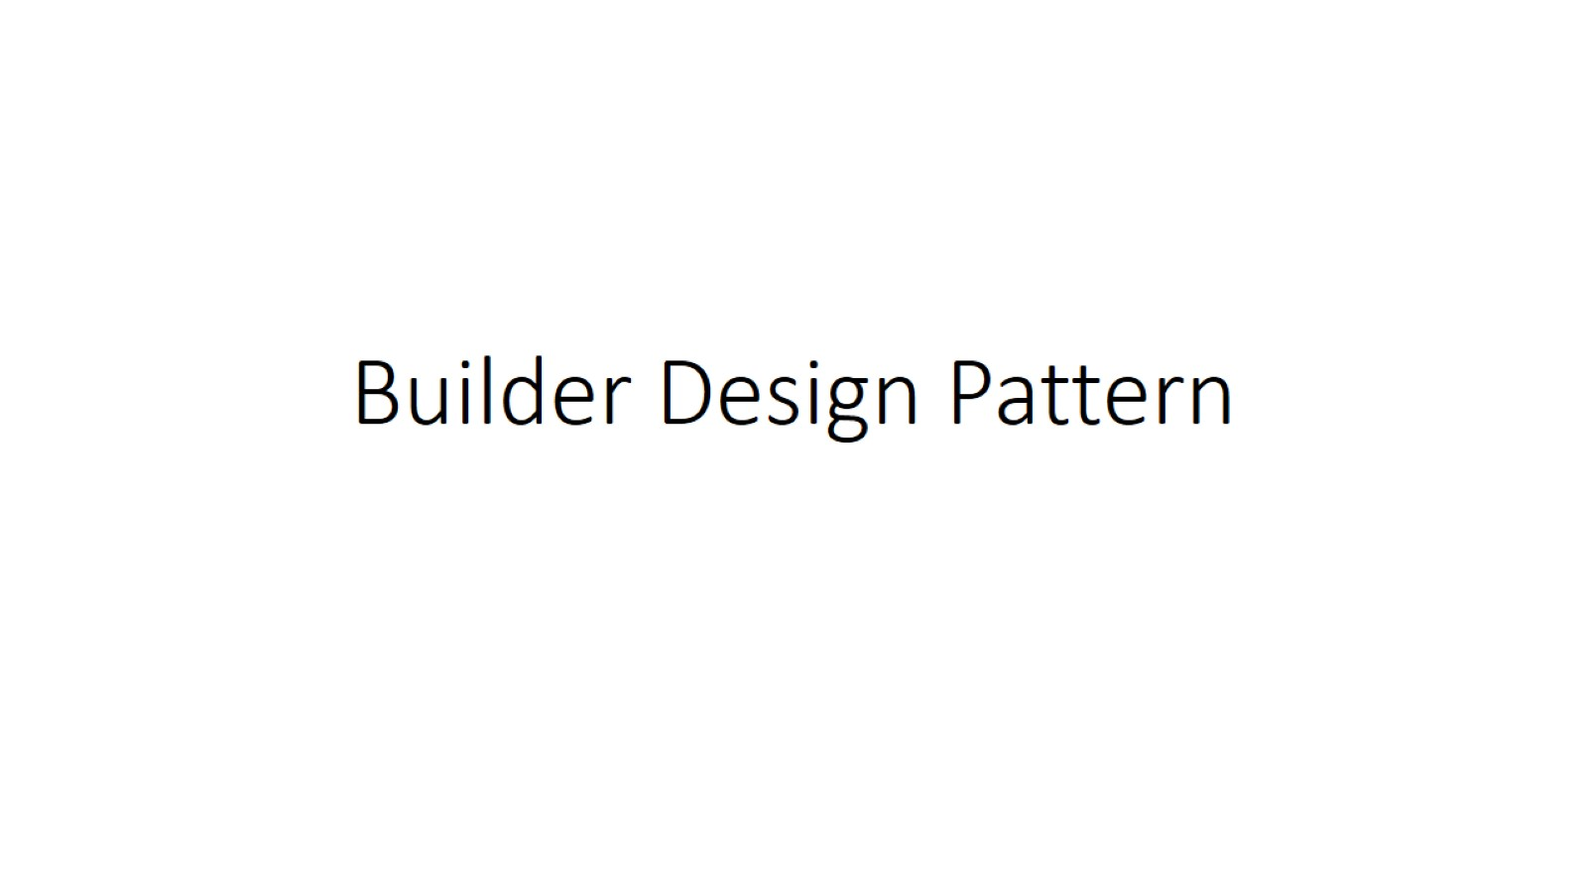
Builder Design Pattern

Slide 2
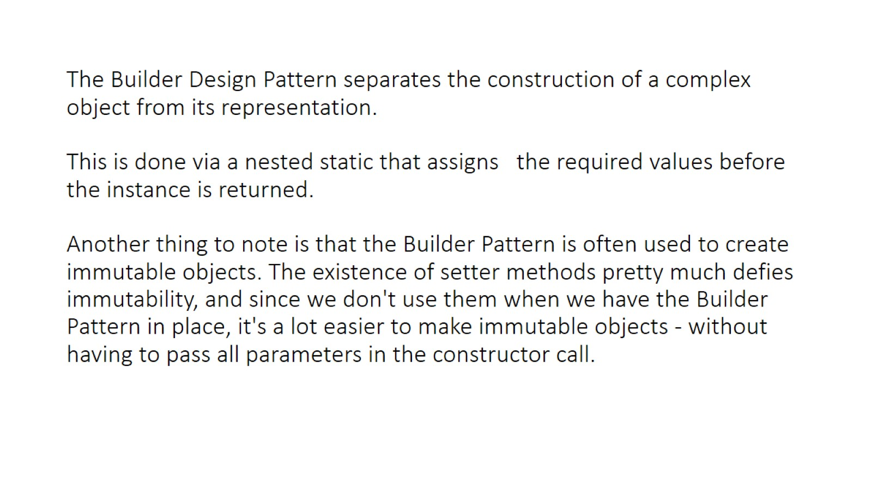
The Builder Design Pattern separates the construction of a complex object from its representation. This is done via a nested static that assigns the required values before the instance is returned. Another thing to note is that the Builder Pattern is often used to create immutable objects. The existence of setter methods pretty much defies immutability, and since we don't use them when we have the Builder Pattern in place, it's a lot easier to make immutable objects - without having to pass all parameters in the constructor call.

Slide 3
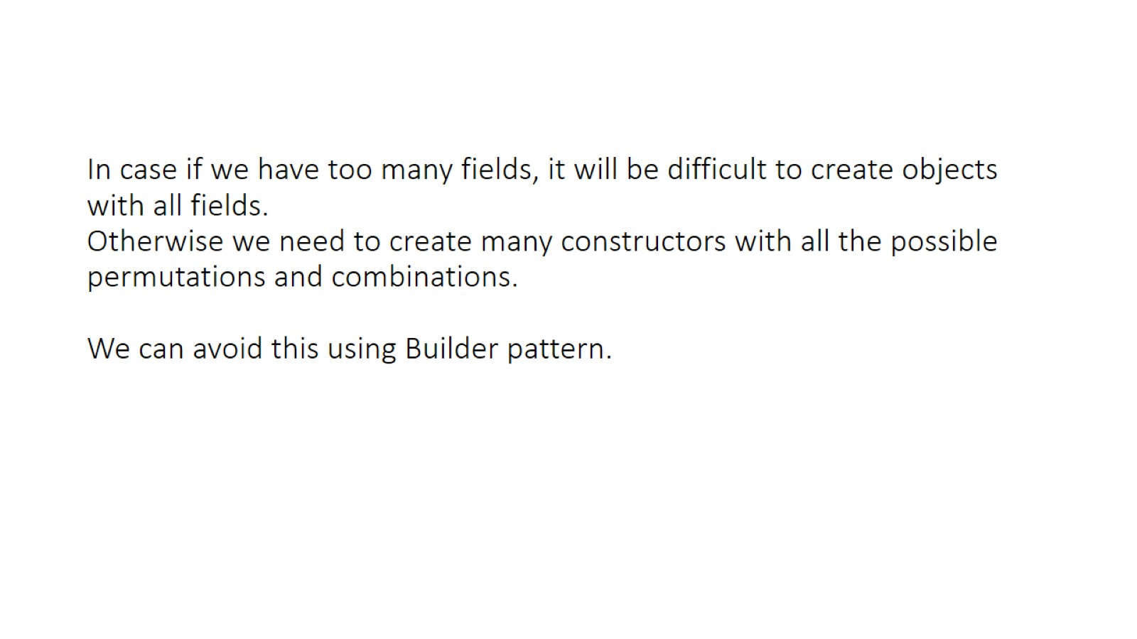
In case if we have too many fields, it will be difficult to create objects with all fields. Otherwise we need to create many constructors with all the possible permutations and combinations. We can avoid this using Builder pattern.

Slide 4
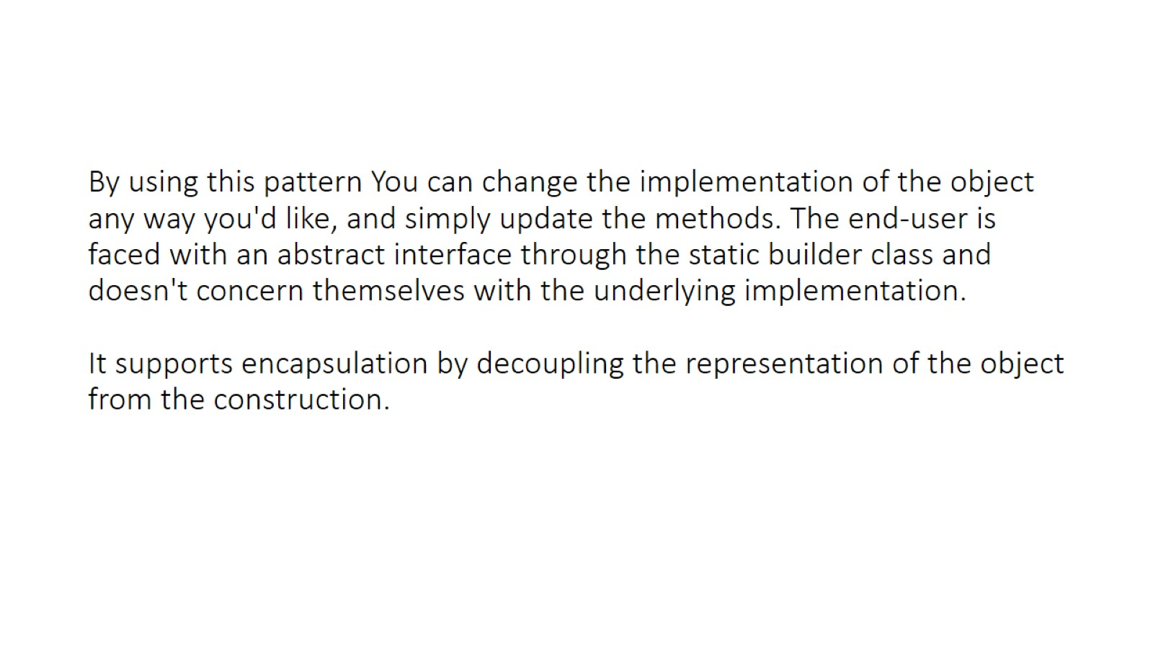
By using this pattern You can change the implementation of the object any way you'd like, and simply update the methods. The end-user is faced with an abstract interface through the static builder class and doesn't concern themselves with the underlying implementation. It supports encapsulation by decoupling the representation of the object from the construction.

Slide 5
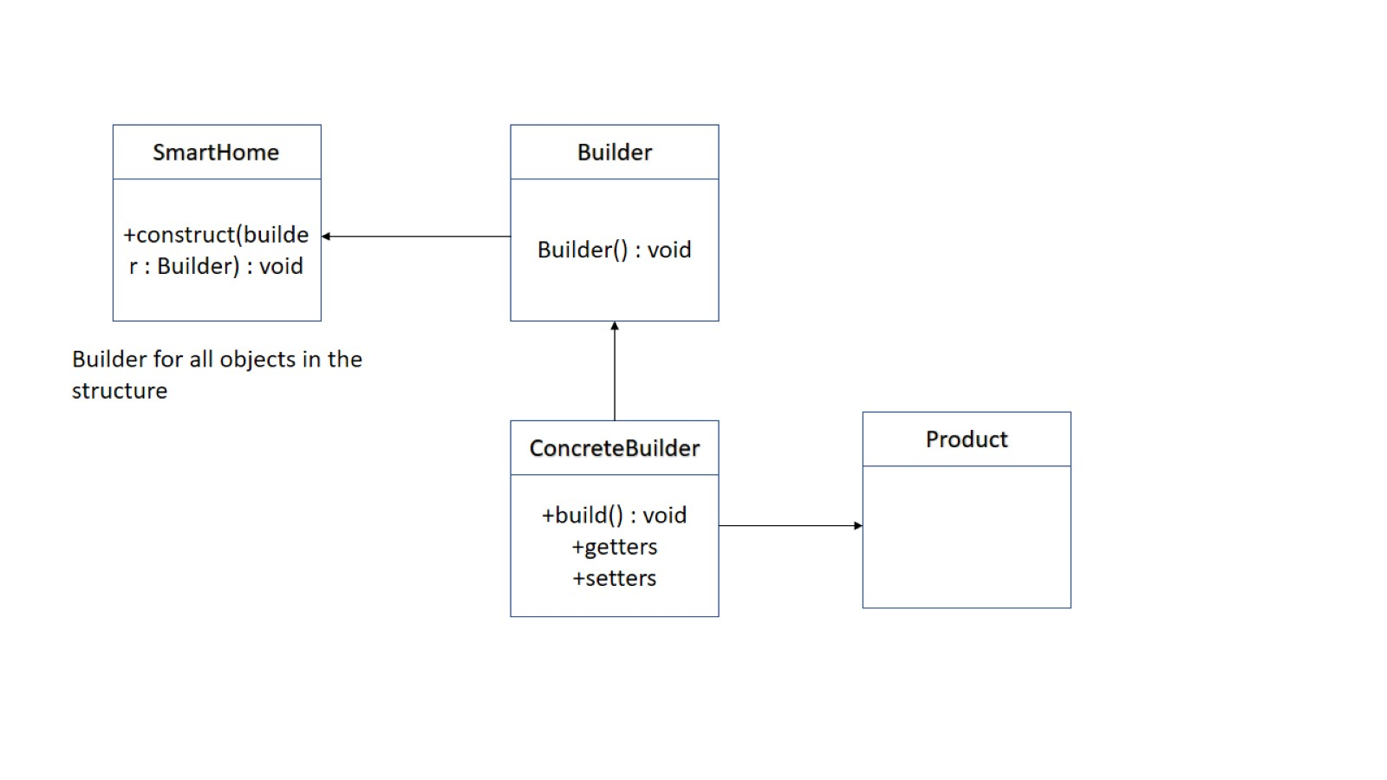

Slide 6
Implementations from JDK : java.lang.StringBuilder#append() [Unsynchronized class] java.lang.StringBuffer#append() [Synchronized class] java.nio.ByteBuffer#put() (also on CharBuffer, ShortBuffer, IntBuffer, LongBuffer, FloatBuffer and DoubleBuffer)

